Slide 1
Presents
OO Programming with Java
An Introduction to Java
Benefits, Products, and Tools
Notes:
Object-Oriented Programming with Java
An Introduction to Java
Module 1

Slide 2
Learning Objectives
Provide an Overview of the Benefits of Java
Discuss the Three Core Java Offerings
  Java Standard Edition (SE)
  Java Enterprise Edition (EE)
  Java Micro-Edition (ME)
Notes:
The references above are to the latest versions of the Java offerings. You will also run across earlier references such as J2SE and J2EE. All are offerings of Java but at different release and specification levels.

Slide 3
Key Java Benefits
Write Once Run Anywhere (WORA)
Object-Orientation
Familiar C/C++ based syntax
Rich Libraries
Security
Internationalization
Performance
It’s Free!
A community process for expanding Java

Slide 4
Write-Once Run Anywhere (WORA)
A Java Application is hosted on a Java Virtual Machine (JVM).
Developers write code for the Java platform rather than a specific platform.
The code is compiled into an “intermediate format” called architecture-neutral bytecodes.
The bytecodes are executed by the JVM and the bytecode instructions are translated into native machine code by the Java Runtime Environment (JRE).

Slide 5
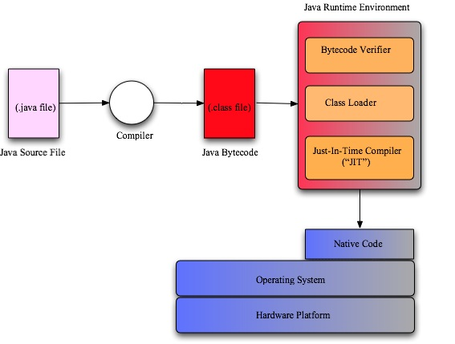
Compilation to Execution
Notes:
The Java Runtime Environment (JRE) is often described as the Java Virtual Machine (JVM). It is technically more correct to say that the JRE provides the JVM.

Slide 6
Portability Implications
The WORA Philosophy allows compiled Java code to be compiled for the JVM and run in any JRE environment.
The JRE is widespread on mainframe, midrange and even mobile platforms!
WORA does NOT completely isolate you from your environment.
Notes:
WORA does NOT completely isolate you from your environment:
It is still possible to write environment/vendor specific code!
The APIs are designed to try and minimize these dependencies through the use of specifications and interfaces.

Slide 7
Java Packages
Throughout this class we will discuss and use Java packages. Packages are Java’s platform-neutral version of directories.
Just as Windows directories are separated by the backslash, the ‘nodes’ of a Java package structure are separated by a dot. For example:
package com.learnquest.calculator.util;
Java programs often use dozens, even hundreds, of individual files. Packages can be used to group these files meaningfully.

Slide 8
Familiar C/C++ Syntax
Java’s syntax is very similar to the C family of languages.
C/C++ developers are able to learn Java quickly.
Java includes the same data types as C: int, float double, etc.
In Java, these non-object data types are called primitives or built in types.
Java uses statements and blocks in much the same way as C. Most of the keywords and operators are the same as well.
Notes:
C was specifically chosen as the basis for Java because so many programmers already knew it..

Slide 9
Rich Library Support
Java provides a comprehensive set of libraries as part of the standard distribution.
These offerings are enhanced with a HUGE selection of reliable and supported open source libraries.
Notes:
Some examples of the standard distribution libraries are:
java.lang - basic abstractions including String, Math and System
java.io - a set of classes for input and output
java.net - a rich set of network-aware communication components
java.util - utilities including data structures and calendar manipulation
java.sql - a set of interfaces and classes for database interaction
java.awt/javax.swing - GUI development libraries
And many, many , many more…
Open Source Library examples include:
http://jakarta.apache.org
http://sourceforge.net

Slide 10
Library Standards
Many of the Java Libraries are based on standards developed within and by the Java community.
Designed to enhance portability by promoting vendor independence.
The Java Community Process (JCP) defines:
  A specification of the API: Interfaces & Required Behavior
Standards-compliant vendors are expected to support this required behavior but the standard will generally not specify HOW it should be implemented.

Slide 11
Extensive Documentation
Java provides thorough documentation, which is available for free on the web at:
https://www.oracle.com/technetwork/java/api-141528.html
The style of documentation seen on the web site can be created for any Java program using the javadoc program, which is included in all Java development kits.
Notes:
Pre-written Java software is readily available on-line.

Slide 12
JDBC: Java Database Connectivity
JDBC packages are a key offering found in java.sql and included as part of the standard Java distribution.
This package facilitates database-neutral interaction with a relational database.
The package provides a set of interfaces that have been standardized by the JDBC specification.
The required behavior is specified by the specification.
The actual implementation of this behavior is determined by the database vendor or some other standards-compliant 3rd party.
Notes:
These concepts will be covered in much more detail near the end of the course.

Slide 13

JDBC
Java Application
Connection Interface java.sql.Connection
Vendor Provided Connection class com.mysql.Connection
Vendor Product : MySQL Database

Slide 14
Security
In a WORA environment, where easy distribution is facilitated by the Internet, guarding against malicious code is a key requirement.
The Bytecode Verifier checks for security violations in compiled bytecodes before it is executed by the JRE.
Java programs now run with client-specified security settings that give them specified degrees of access to local resources.

Slide 15
Internationalization
All character data is stored using the 16-bit Unicode standard.
This covers both the phonetic and ideographic character sets of the entire world.
The standard Java libraries also support the concept of “localization” for specific geographic/cultural needs.
Notes:
The standard Java libraries also support the concept of “localization” for specific geographic/cultural needs:
♦ e.g. Different Calendar classes for different dating systems (e.g. Gregorian versus Julian Calendars)

Slide 16
Performance
Enhancing Java performance has been a key feature of the later Java Runtime Environment.
In JDK 1.0 Java reportedly ran 20 times slower than a C-based native executable.
  This problem has been significantly mitigated in later releases.
The performance of Java is now “comparable” to native executables.
Notes:
In JDK 1.0 Java reportedly ran 20 times slower than a C-based native executable:
This problem has been significantly mitigated in later releases:
♦ Key optimizations such as “Just In Time” compilers that convert Java bytecodes to native machine code on-the-fly
♦ Advanced compilation of computationally expensive code such as String manipulation to native format

Slide 17
It’s Free!
Java is NOT open source but private and commercial licensing is available on a royalty-free basis.
The source for all libraries is also made available for viewing.
Java development tools are available to all at https://www.java.com/en/download/manual.jsp
Notes:
Although a commercial IDE is quite useful, Java can be written with a simple text editor like “Textpad.”

Slide 18
Java Product Suite
Java is available in three distinct editions:
  Java Standard Edition (SE)
  Java Enterprise Edition (EE)
  Java Micro-Edition (ME)

Slide 19
Java Standard Edition (SE)
The core offering that underpins both the Enterprise Edition and the Micro Edition
Composed of a Java Runtime Environment (JRE) and a Software Development Kit (SDK) for programming in Java
Key Tools:
  javac
  java
  javadoc
  jdb
For non-developers, it is possible to get a stand-alone JRE.
Notes:
Key Tools:
♦ javac: the Java Compiler
♦ java: the SDK JRE environment for executing Java programs
♦ javadoc: a tool for developing standard API documentation from embedded comments in code
♦ jdb: Java debugger

Slide 20
Java Enterprise Edition (EE)
Defines a set of standard APIs for multi-tier enterprise scale applications
Designed to work in conjunction with an application server environment such as WebSphere
Provides the following core APIs:
  Java Servlets and Java Server Pages (JSP)
  Enterprise Java Beans (EJB)
  Java Messaging Service (JMS)
  Everything provided by the Standard Edition
Notes:
Provides the following core APIs:
Java Servlets and Java Server Pages (JSP) for web application development
Enterprise Java Beans (EJB) for developing business components
Java Messaging Service (JMS) for providing access to asynchronous messaging middleware products such as MQ
Everything provided by the Standard Edition

Slide 21
Java EE API
JDBC Core API
RMI-IIOP API
JNDI API
JDBC Extensions 2.0
EJB (Enterprise Java Beans)
Servlet API
JSP (Java Server Pages)
JMS (Java Message Service)
JTA (Java Transaction API)
JavaMail
Java Activation Framework (JAF)
JAXP (Java API for XML Parsing)
Java Connector Architecture (JCA)
JAAS (Java Authentication and Authorization Service)

Slide 22
Java Micro-Edition (ME)
Defines a set of APIs and Configurations for Embedded and Mobile Devices
Configurations facilitate the packaging of a JVM and a restricted set of APIs to match the capabilities of a specific type of device
  Such devices are typically limited in terms of processor speed and available memory
  Two configurations currently available
Notes:
Configurations facilitate the packaging of a JVM and a restricted set of APIs to match the capabilities of a specific type of device.
♦ Such devices are typically limited in terms of processor speed and available memory
♦ Two configurations currently available:
♦ CLDC - Common Limited Device Configuration
♦ CDC - Common Device Configuration

Slide 23

JDK vs. JRE Installation
Developers wishing to write Java programs need to install the “Java Development Kit” for whichever release of Java they want to use.
Anyone who wants to run Java programs, but not write them, can download the much smaller Java Runtime Environment..
Above we see one JDK and two JREs installed on the same system.

Slide 24
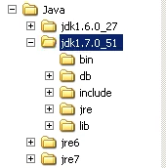
The Installed JDK
To the right you can see the directory structure of jdk1.7.0_51
The bin directory holds the tools to create Java programs.
The lib directory holds support files (.jars).
The runtime environment is in the jre directory.

Slide 25
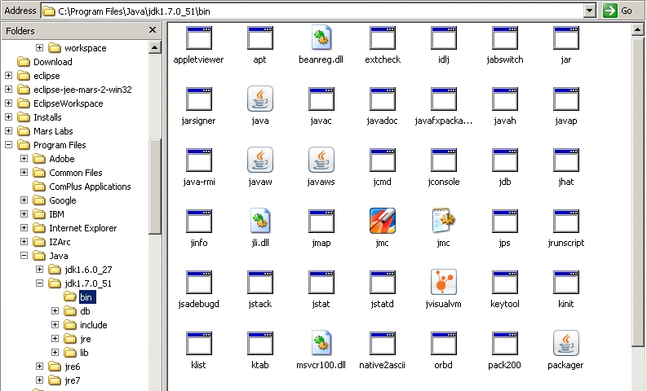
The bin Directory

Slide 26
Important Files in the bin Directory
java.exe – Executes java code
javac.exe – Compiles Java source code
javadoc.exe – Reads Java source code files and creates HTML base documentation from them
jar.exe – Takes a collection of compiled java classes and bundles them into a single file called a “jar file ”
Note that in non-Microsoft systems, these files would have the same names but without the “.exe” extension.
Notes:
Object-Oriented Programming with Java

Slide 27
Running Java
Java commands can be run from a command shell (Unix) or on Windows systems at the “Command Prompt.”
To do this, you would run java.exe followed by some (optional) parameters and the name of the java program you want to run. For example:
java –classpath C:\MyJavaCode com.lq.SayHello
In this class we will use a development tool, called an IDE, to create and execute our Java programs.
Notes:
The Integrated Development Environment (IDE) will simplify creating source code, debugging, testing and executing.

